Slide 1
Project 1b.
Persona + Storyboard + Low Fidelity Prototype
By Isaac Tan | 2100902B | Class: P11

Slide 2

Ferturb bom
Ferturb is a marine biologist who studies the evolution and characteristics of penguins and works part time at the Singapore zoo taking care of penguins. Every day after work, it has become a habit for him to whip out his phone and listen to music for his 30-minute bus ride home the moment he steps out of his workplace building. Despite already cultivated this habit, he still faces frustrations as he cannot pin his frequently-listened playlist on the home page where he can directly be redirected to the specific playlist. Instead, 6 playlists are always grouped together on the main page and are not always fixed in their places but are always mixed up. Hence, natural human error occurs, and he will always press the playlist at that location where he thinks is his favourite playlist until he gets used to the random shuffling positions of playlists and accepts that the they are not always fixed in the same locations.
To be able to start playing his favourite playlist of songs within 2-3 clicks of buttons
Cannot pin his favourite playlists on the home page and has to manually go to his library of playlist and select that playlist
Number of playlists on main page are too many and quite small, and are not always fixed in their locations, always mixed up around the few playlist displayed on the top section of the home page.
These errors causes Ferturb to spend more time looking at his phone trying to get to the playlist and play the song – accidents may occur such as car accidents or bicycle accidents or bump into people as not paying attention on the road.
“I want to use a music player app where I can easily access my playlists within 2-3 clicks with easy navigation.”
Outgoing
Sociable
Persevering
Spotify
SoundCloud
24
Marine Biologist
Single
Singapore
Passionate about music

Slide 3
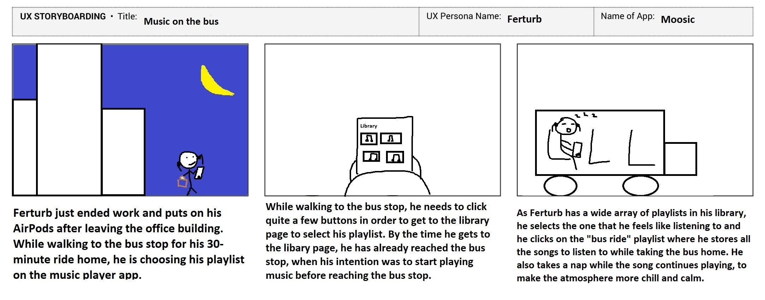

Slide 4
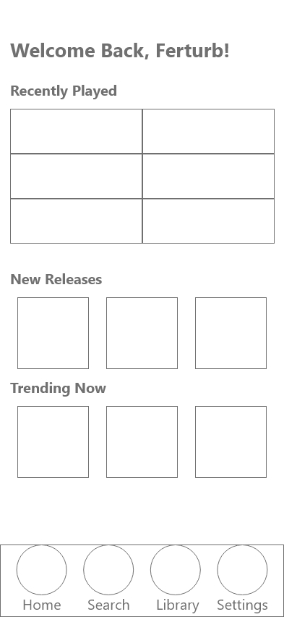
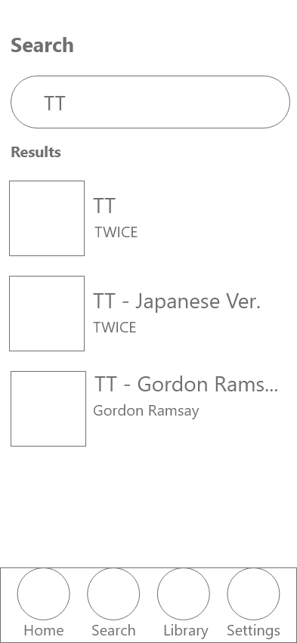
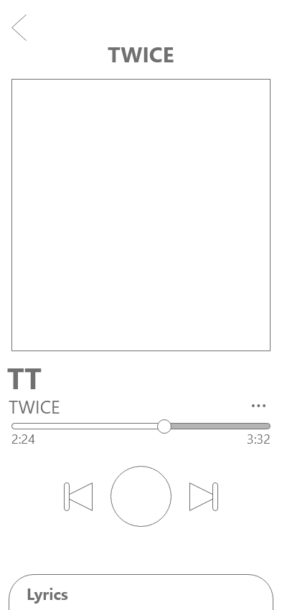
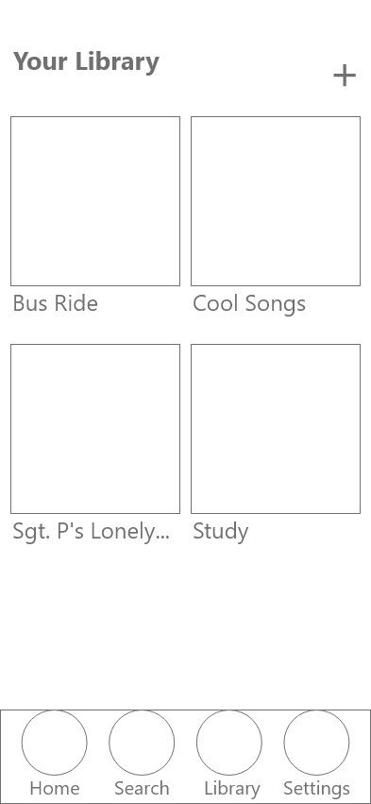
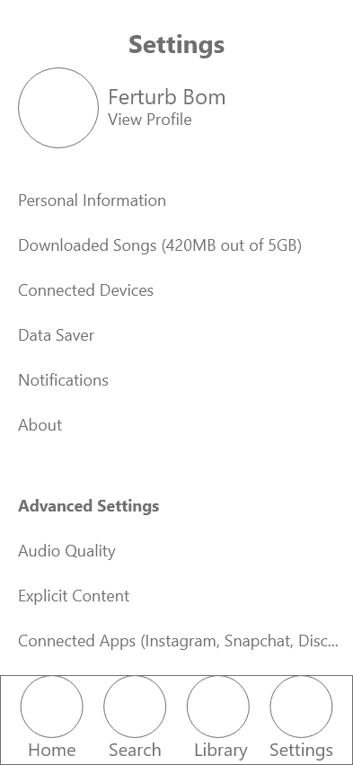
Low-fidelity prototype: overview
1. App Home Page
2. Searching for song
3. Playing music
4. Library page
5. Settings Page
Preview online: https://xd.adobe.com/view/71205d6d-6318-4bc6-923a-5e9668f40763-2473/

